Slide 1
June 2024

Slide 2
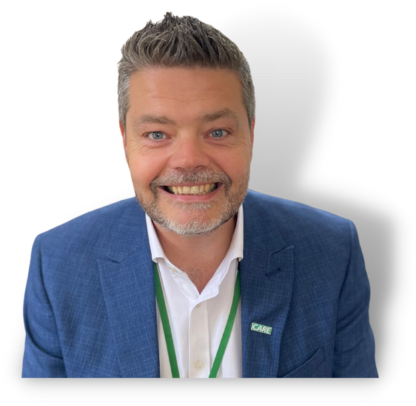
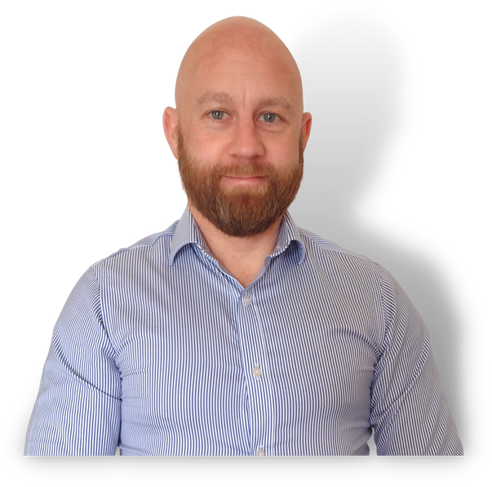
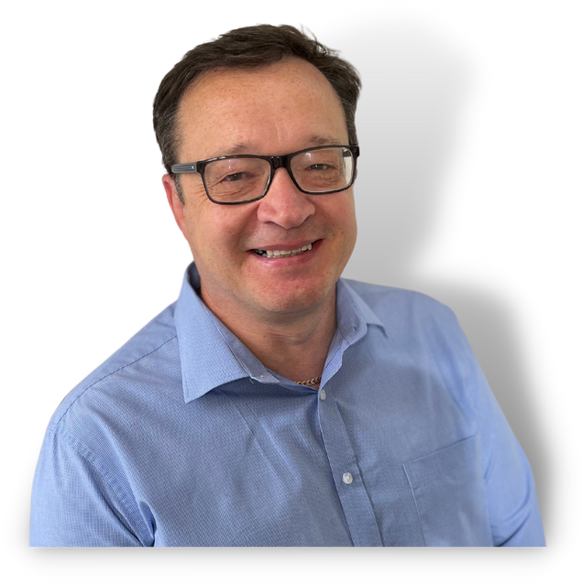
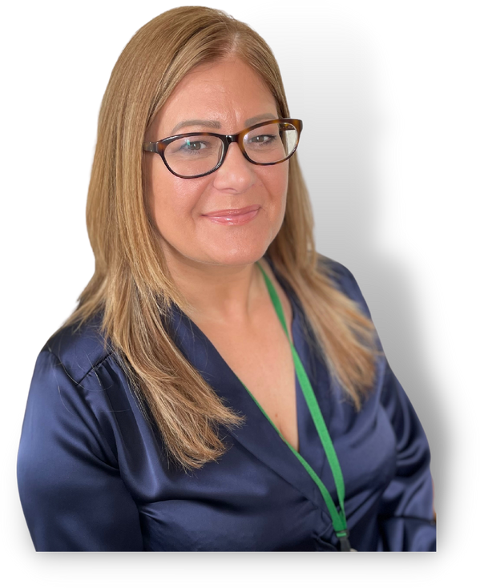
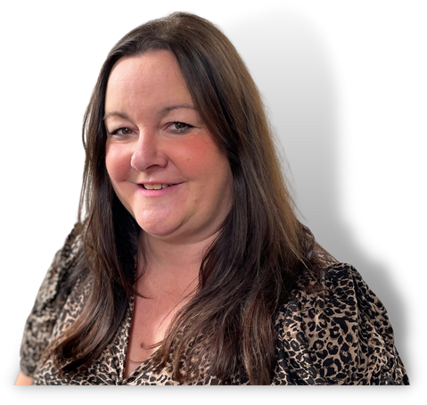
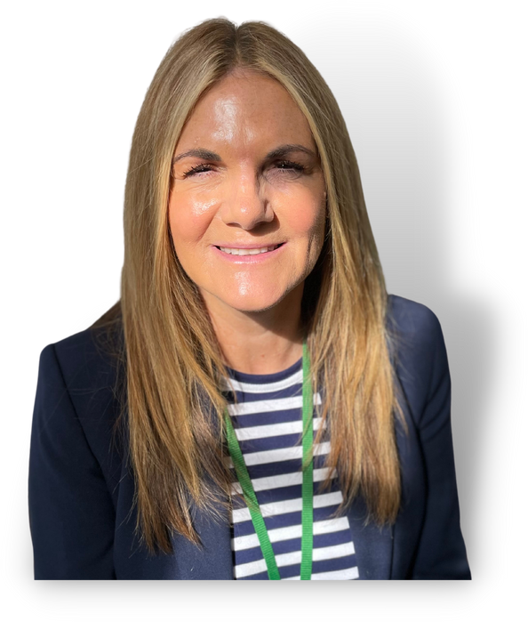
Our Executive Team
John Heritage
Chief Executive @DavidLewisCEO
Neil Edwards Director of Finance & Estates
Responsible for:
Finance
Estates
Facilities
Company Secretary
Simon Messenger
Director of Adult Residential
& Day Opportunities
Responsible for:
Adult Residential Services and Day Opportunities
Victoria Entwistle
Director of Clinical Services, Quality & Compliance Responsible for:
Clinical Services Safeguarding (Exec Lead) Health & Safety
Quality
Sue Hunt Director of People, Culture & Systems
Responsible for:
Recruitment
Training
Workplace Mentor scheme
Human Resources
IT/Systems
Communications
Angie Fisher
Director of Education
Responsible for:
School 11-16
College 16+

Slide 3
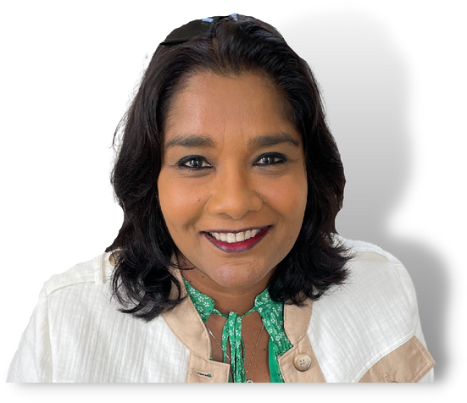
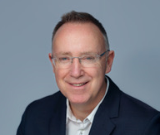
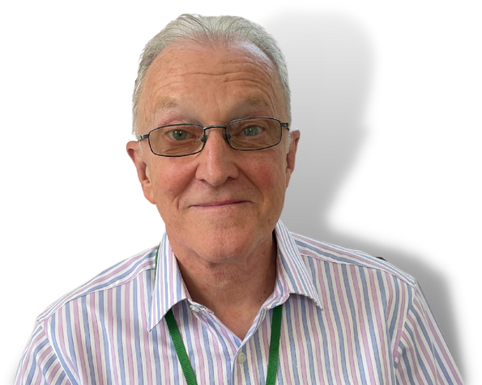
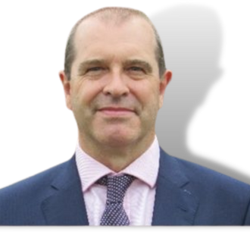
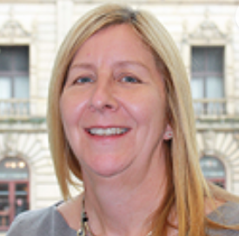
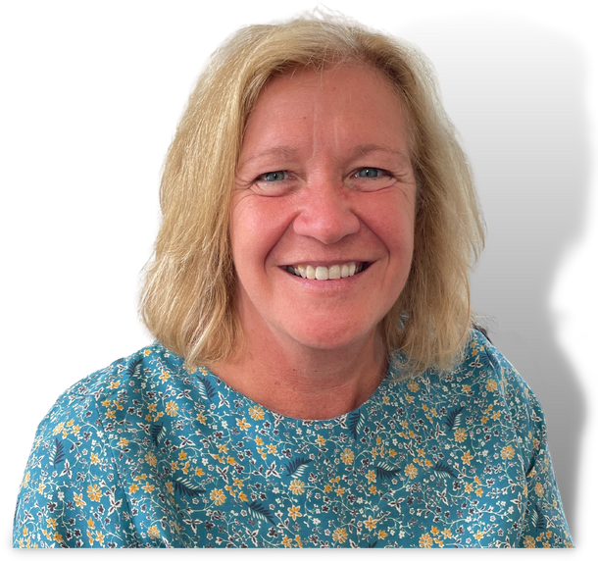
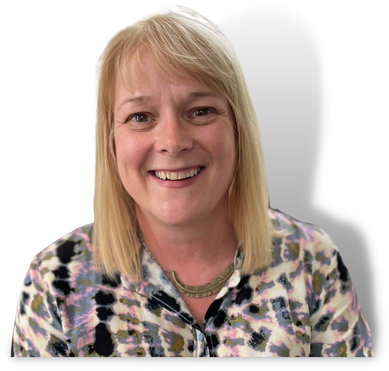
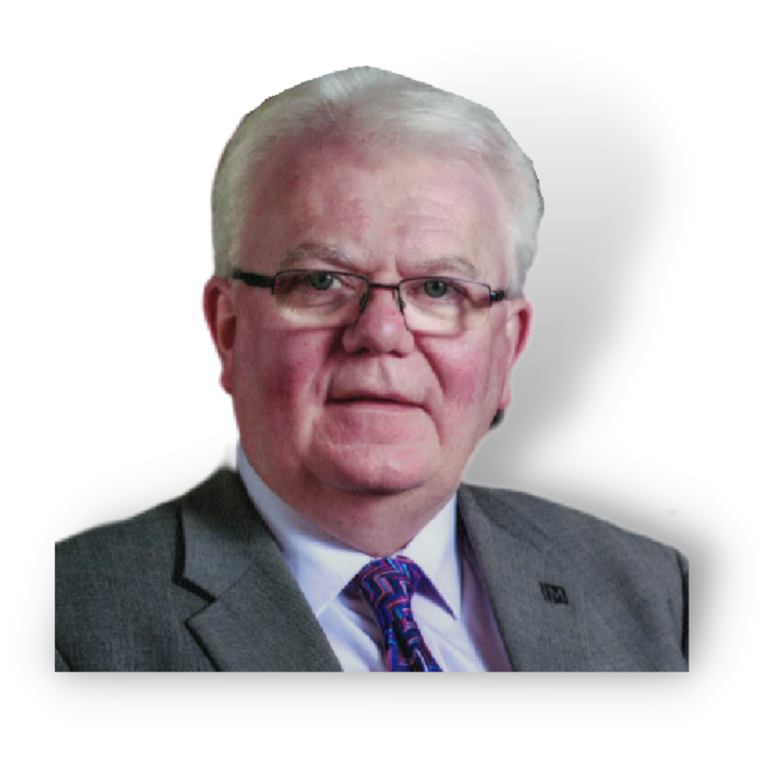
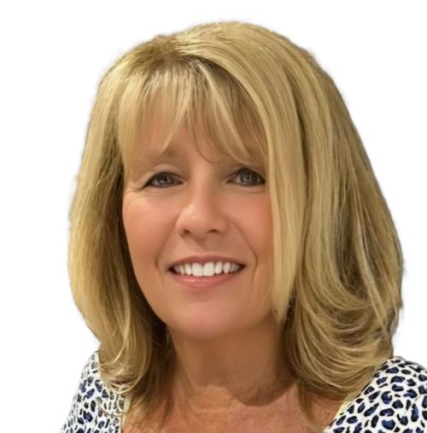
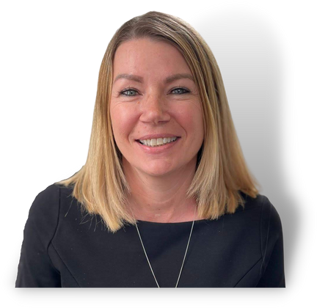
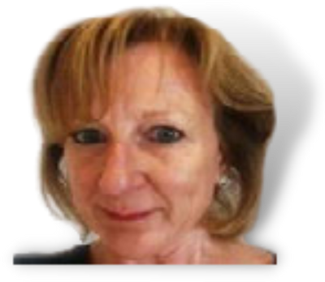
Our Trustees
Tricia Kalloo
Chair
Paul McKevitt
Trustee
Geoff Loughlin
Vice-Chair
Alistair Hollows
Trustee
Elaine Cartwright
Trustee
Carole Spencer
Trustee
Professor Vicky Halliwell
Trustee
Lisa Ellis
Trustee
Paul Brearley
Trustee
Susan Tebby-Lees
Trustee
Christine Green
Trustee

Slide 4
Committee Structure
 | Risk, Safety & Governance Committee | Resources Committee | School Governors | College Governors
Trustees | Geoff Loughlin (Chair) Lisa Ellis | Alistair Hollows (Chair) Carole Spencer Paul McKevitt | Dr Victoria Halliwell (Chair) Paul Brearley | Carole Spencer (Chair) Geoff Loughlin
External Co-opted Member | Dave Rooney
Executives | All Executive Team | Neil Edwards Sue Hunt John Heritage | Angie Fisher John Heritage | Angie Fisher John Heritage

Slide 6
Adult Residential & Day Opportunities
Director of Adult Residential & Day Opportunities
Simon Messenger
Head of Day Opportunities
Donna Haworth
Registered Manager
Darren Brodrick
Registered Manager
Deborah Davey
Registered Manager
Dave Robins
Registered Manager
Alex Smith
Residential Managers
Kara Armitt
Santina Corfield
Caroline Downing
Liam McMorine
Kara Chesters (Residential Operational Manager)
Residential Managers
Sara Adams
James Barter
Kirsty Booth
Tracey Hall
Kathryn Harmer
Day Opportunities Managers
Hannah Lowry
Elizabeth Page
James Miller
Nights Supervisors
Janet Brown
Melonie Hodkinson

Slide 8
Education
Director of Education
Angie Fisher
School
College
Administrator/Clerk to the Governing Body
(School)
Tracy Donaldson
Head of School
Kate Tierney
Admissions Manager
Gilly Godwin
Deputy Head of Education – Head of College
Zoe Wright
Administrator/Clerk to the Governing Body
(College)
Janet Ford
Student Services Manager
Tina Hooson
Assistant Principal
Joanne Hall
Teachers
Assistant Head
Hannah Lafferty
Lily Carney
Teachers
Learning Support Staff
Careers & Pathway Manager
Kirsty Stanley
Learning Support
Staff
Pathway Coordinator
Amanda Bates

Slide 10
Clinical Services, Quality & Compliance
Director of Clinical Services, Quality & Compliance
Victoria Entwistle
Head of Social Work and Welfare
Becci Peart
Head of Clinical Service & Quality
Claire Munro
IPC, Meds Management & Named Nurse for School & College
Jackie Lamb
Doctors
Dr Paul Cooper (Medical Director)
Dr Tawfeeq Arkan
Safeguarding
(DSL School)
Raisa Tryon
Social Work Assistant
Greg Shelley
Centre Cover Nurses
Psychiatrist (Medical Director from July 2024)
Dr Tessa Myatt
Specialist Nurses
Speech and Language Therapy
Quality Assurance Manager
Niamh Campbell
Positive Behaviour Support Team
Physio/Occupational Therapy
Health & Safety Support Officer
Colin Pennington
Board Certified Behaviour Analyst
Wellbeing Team

Slide 12
People Culture & Systems
Director of People, Culture & Systems
Sue Hunt
Learning & Development Manager
Simon Priest
Recruitment
Lead
Craig Hughes
HR Business Partners
Jane Halliday
Catherine Simpson
Information & Applications Manager
Martin Day
Communications Manager
Eleanor Hanrahan
HR Advisor
Alex Barlow
Vacancy
IT Systems Engineers
Jamie Bowler
Tim Stuttard
Training & Development Team
Dominic Green
Nick Bonnington
Zowie Jupp
HR Assistants
Laura Luckman
Charlotte Thomas (Mat/L)
Larah (Temp)
Workplace Mentors
Janet Thorpe
Abigail Walker
HR & Training Assistant
April Oakes
Recruitment Administrators
Victoria Moran
Victoria Roberts

Slide 14
Finance and Estates
Director of Finance and Estates
Neil Edwards
Financial Accountant
Pat Brown
Management Accountant
Alex Perritt
Payroll Manager
Amanda Owen
Reception Team Leader
Maria Noone
Estates Manager
Paul Craven
Payroll Assistant
Vacant
Admin Receptionists
Caroline Batchelor
Jacob Martinez
Zosia McPherson
Sales Ledger Administrator
Sheena Brazil
Maintenance Supervisor
James Bentley
Assistant Financial Accountant
Sam Boughey
Maintenance, Gardens and Transport
Archive Assistant
Anne Gawley
Purchase Ledger Clerk
Yvonne Busby
Kitchen Manager – Paul Yates
Cleaning Manager - Carol Jones
Laundry & Stores Supervisor – Paul Wright.
Night Reception Team Leader
Peter Malpass
Assistant Accountant
Christine Cole

Slide 16
Chief Execs Office
Chief Executive Officer
John Heritage
Personal Assistant
Carol Davies
Fundraising & Partnerships Lead
Sarah Johnson
Co-Production Lead
Maria Flanagan
Trust & Foundation Fundraiser
Gayle Derrick

